Slide 1
Introduction to Computers
IP / Address
By Andre Adura

Slide 2
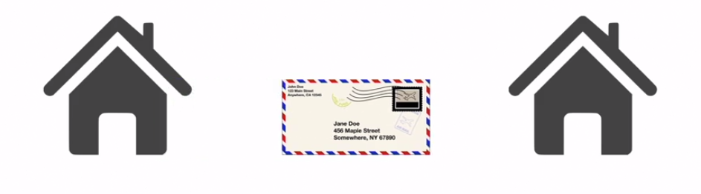
IP(Internet Address) – "It's a network address for your computer so the Internet knows where to send you emails, data and pictures of cats." Source: https://whatismyipaddress.com/ip-address
In the same way you need a mailing address to receive a letter in the mail from a friend, a remote computer needs your IP address to communicate with your computer.

Slide 3
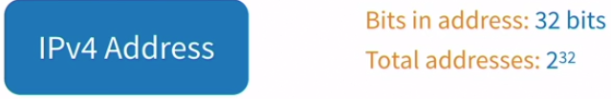
The IPv4 Address.
The common type of IP address (is known as IPv4, for "version 4"). Here's an example of what an IP address might look like:
66.171.248.170
An IPv4 address consists of four numbers, each of which contains one to three digits, with a single dot (.) separating each number or set of digits. Each of the four numbers can range from 0 to 255.

Slide 4
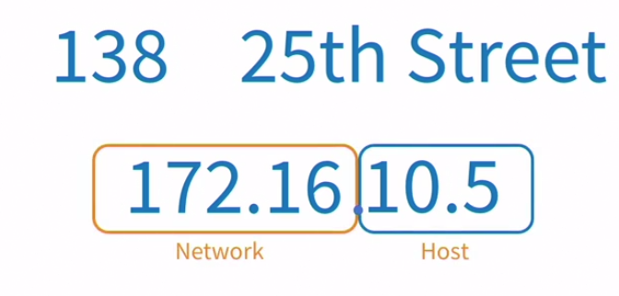
4.3 Billion of combinations

Slide 5
What would happen if we ran out of IP addresses?
Guess what—we did!
Suddenly, major companies (even Microsoft!) were scrambling to buy unused IP addresses from other companies...for millions of dollars.
What went wrong?
The past decade has seen explosive growth in mobile devices including mobile phones, notebook computers, and wireless handheld devices. The format for IPv4 wasn't designed to handle the sheer number of IP addresses.

Slide 6
Goodbye IPv4. Hello IPv6.
It's called IPv6 and it offers a maximum number of IP address for today and for the future.
Whereas IPv4 supports a maximum of approximately 4.3 billion unique IP addresses, IPv6 supports, in theory, a maximum number that will never run out.

Slide 7
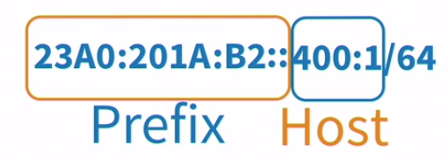
Endless combinations?
A theoretical maximum of 340,282,366,920,938,463,463,374,607,431,768,211,456. To be exact. In other words, we will never run out of IP addresses again.

Slide 8
IPv6
An IPv6 address consists of eight groups of four hexadecimal digits. If a group consists of four zeros, the notation can be shortened using a colon to replace the zeros. Here's an example IPv6 address:
2001:0db8:85a3:0000:0000:8a2e:0370:7334

Slide 9
How to Hide Your IP Address
You can borrow a different IP address to go anywhere online and stay hidden.
The reasons why you might want to mask your IP address may include: Hiding your geographical location, preventing Web tracking, avoiding a digital footprint, or to bypass any content filters, bans or blacklisting.
Use a VPN Service – The Best Way
Sign up with these services and when you go online, you'll be showing the world a different IP address...one that's on loan from the service you're using.

Slide 10
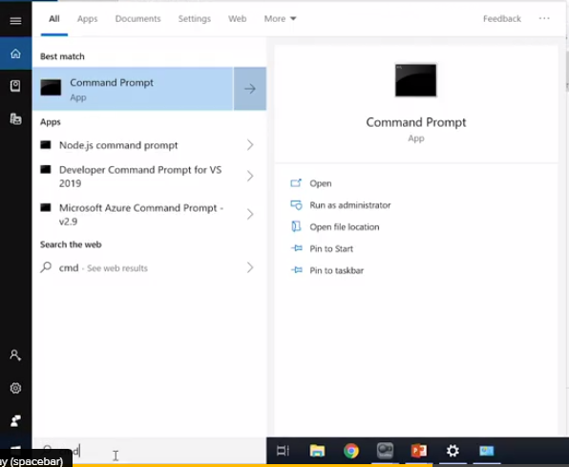
Let’s find out your IP:
Windows: Open the Command Prompt by typing cmd on the search bar
Mac: Open the Spotlight(Command + Space) and type Terminal

Slide 11
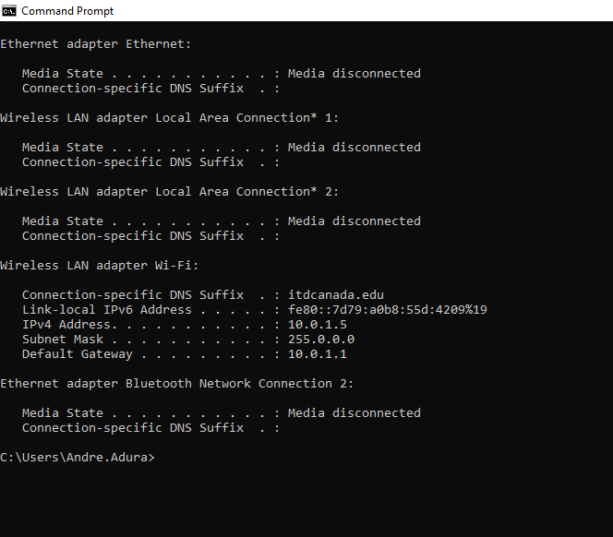
Now type “ipconfig” and press Enter
MAC: ifconfig
You’ll be able to check:
IP Address
Subnet Mask
Default Gateway
Notes:
4D2 to decimal

Slide 12
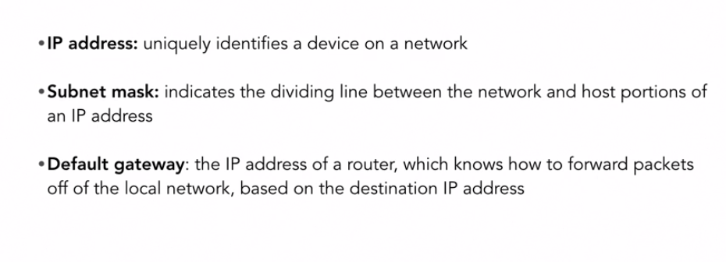

Slide 13
What about the MAC Address (media access control)
Whether you work in a wired network office or a wireless one, one thing is common for both environments: It takes both network software and hardware (cables, routers, etc.) to transfer data from your computer to another—or from a computer thousands of miles away to yours.
And in the end, to get the data you want right to YOU, it comes down to addresses.
So not surprisingly, along with an IP address (which is networks software), there's also a hardware address. Typically it is tied to a key connection device in your computer called the network interface card, or NIC. The NIC is essentially a computer circuit card that makes it possible for your computer to connect to a network.
An NIC turns data into an electrical signal that can be transmitted over the network.

Slide 14
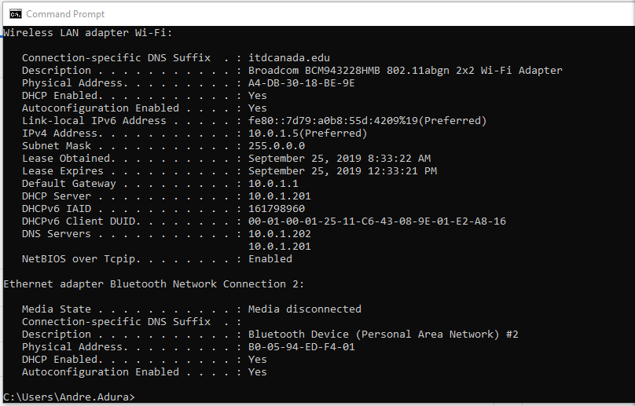
Let’s find your MAC Address:
Type: “ipconfig /all”
Mac: ifconfig
Your MAC Address is listed as:
Physical Address
Notes:
C89 to binary

Slide 15
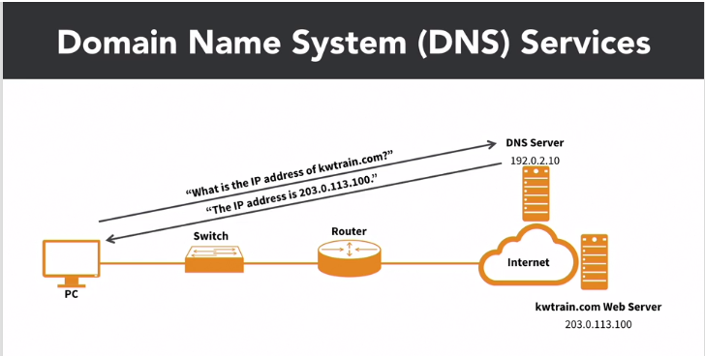
DNS(Domain Name System)
The Domain Name System (DNS) is the phonebook of the Internet. Humans access information online through domain names, like nytimes.com or espn.com. Web browsers interact through Internet Protocol (IP) addresses. DNS translates domain names to IP addresses so browsers can load Internet resources.

Slide 16
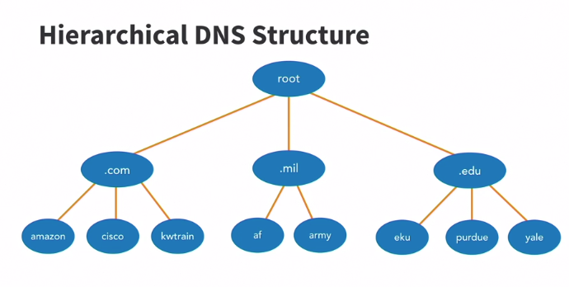
Website IP
172.217.3.206 – Go to this Website
Notes:
4D2 to decimal

Slide 17
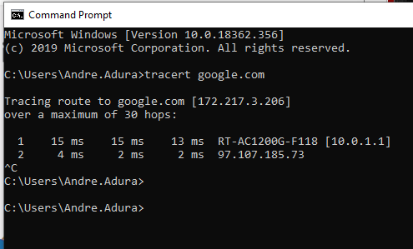
Tracing route to Website IP
Use the “tracert” command to find an IP address

Slide 18
Supplementary information
https://whatismyipaddress.com/ip-address
Texts and tutorials about IP

Slide 19
Exercises
Find the IPv6 of your computer and convert it to binary
Choose a topic, pick 3 websites about it and find out they IP’s

Slide 20

From the ITD Canada team!!!

